Slide 1
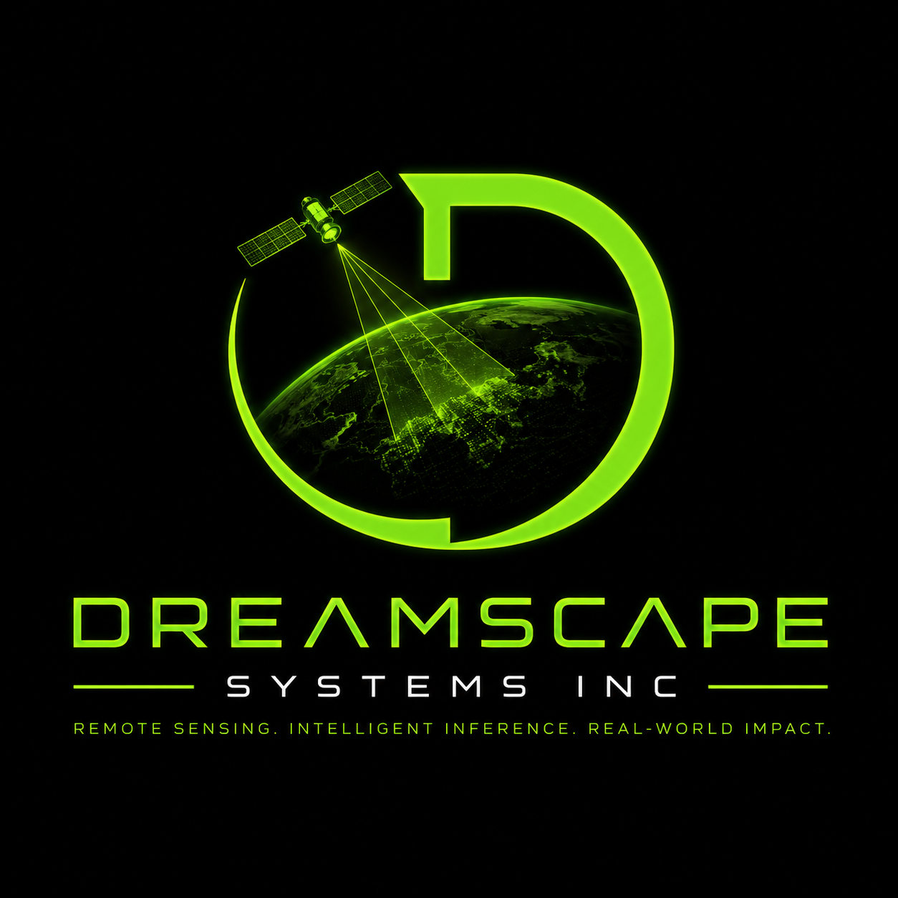
Shed Some Light on the Matter
DreamScape Systems
Inc.
DreamScape Systems Inc. is looking for Pre-Seed funding for novel optics sensor technology for cryptanalysis, remote sensing applications, and biomedical imaging.
A unified hardware sensor platform exploiting structured light (OAM, vortex photons, skyrmions, hopfions) as a universal measurement primitive across remote sensing, edge inference, bio-imaging, post-quantum cryptanalysis, and gravitational astronomy.
Trevor Nestor, Sarah Sullivan, David Nisanov, Brian Thompson, Aniket Sur
Delaware C-Corp • USPTO Provisional 63/910,939 • Pitch Deck v1.0 • May 2026
Dreamscape Systems Inc. | trevornestor@dreamscapesystemsinc.com | dreamscapesystemsinc.com
1 / 13

Slide 2
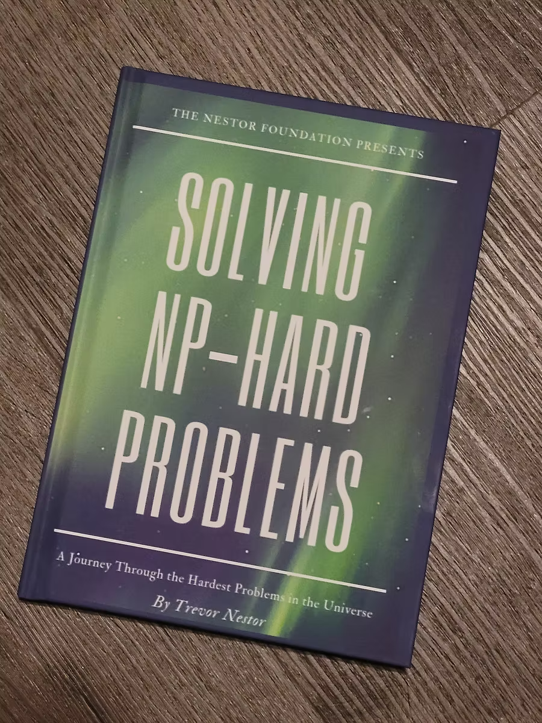
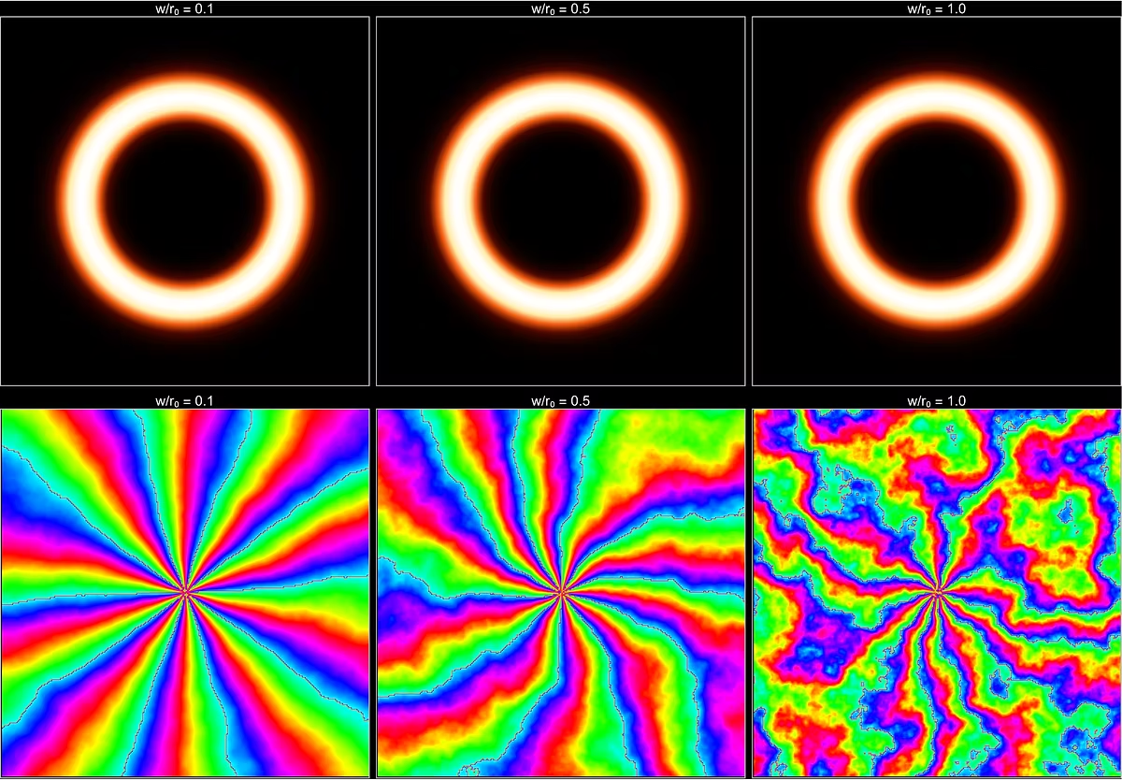
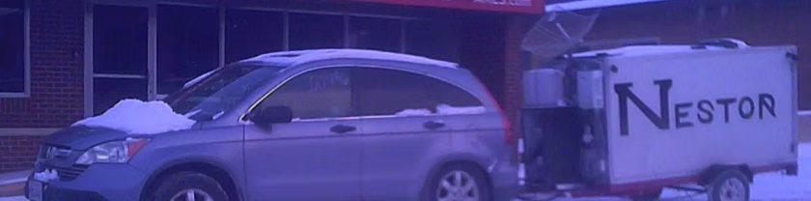
Founder Story…
It all started with a quest to answer one question - what makes us humans different from machines?
In 2010, Trevor Nestor, appealing to Godel’s Incompleteness theorems, bet his friend Pedro Amaral at the University of California, Berkeley, that Stephen Hawking was wrong - that it was not possible to emulate a human mind in a classical computer - and that the brain must operate on new physics to explain perceptual binding. As it turns out, this physics sits at the intersection of new technology that will become central to the future of remote sensing, post-quantum cryptanalysis, energy efficient edge computing, novel methods of bio-imaging, and even gravitometry.
It was then Trevor Nestor was introduced to the work of Dr. Penrose: “The Emperor’s New Mind” where he was surprised to find that Dr. Penrose - the mentor of Stephen Hawking - had come to the same conclusion. To make matters more interesting - the perceptual binding problem was related to lattice problems implicated in post-quantum cryptography - and Trevor’s professor Dr. Borcherds was a fields medalist and expert in both lattice maths as well as theories of quantum gravity.
After living off-grid for several months in the harshest possible conditions (the Iowa winter where it was measurably colder than the arctic, and in the Arizona desert summer) traveling the United States in a trailer he had built, Trevor Nestor went on to work at a research and development subsidiary of Boeing (Aurora Flight Sciences), lived in Boulder, Colorado (where NIST finalized new post-quantum cryptographic standards) working at Meta in robotics, at Microsoft (where they are studying Majorana physics), and then finalized his ideas in coordination with Dr. Vopson at the Information Physics Institute in the UK - forming the basis for technology harnessing the physics of what makes us unique that current AI architectures cannot replicate.
Dreamscape Systems Inc. | trevornestor@dreamscapesystemsinc.com | dreamscapesystemsinc.com
1 / 13

Slide 3
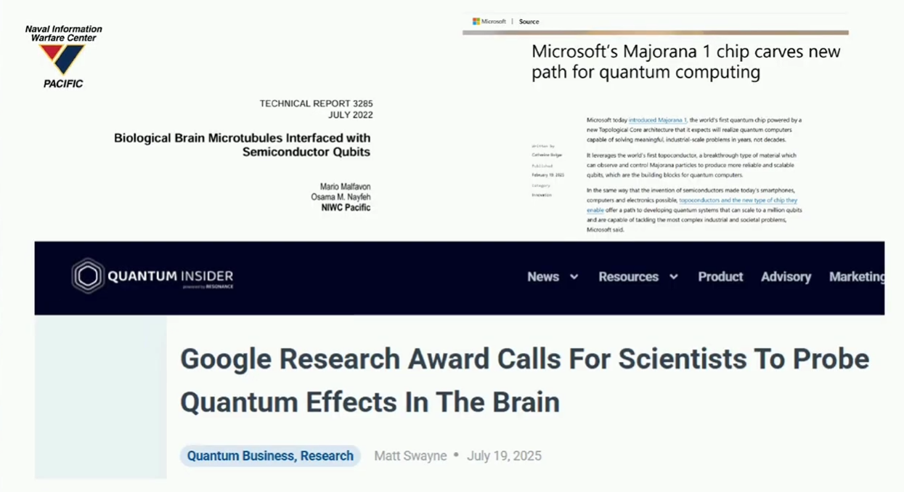
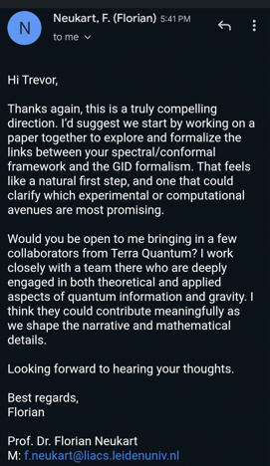
Structured Light is the Key
Optical/Spin systems have caught the interest of the world’s most powerful governments, leaders, corporations, and academics where it has been taken very seriously.
Dreamscape Systems Inc. | trevornestor@dreamscapesystemsinc.com | dreamscapesystemsinc.com
1 / 13

Slide 4





CONFIDENTIAL
Five hard problems. One missing measurement axis.
All five push against the same engineering ceiling: light's spatial structure has been ignored as a degree of freedom outside specialty optics labs.
Remote sensing
Edge inference
Live-tissue imaging
Lattice cryptanalysis
Gravitational astronomy
Classical EO/SAR cannot resolve foliage-obscured drones, sub-vegetation mineral signatures, or wake vortices from aircraft and submarines.
AI inference is hitting a hard energy wall. The brain runs at 20 W; hyperscalers are signing nuclear PPAs to keep up.
Living tissues emit superradiant ultraweak Majorana-like vortex biophotons signals. Confocal and multiphoton microscopy bleach photo-sensitive samples and miss functional contrast in living neurons.
NIST post-quantum schemes rest on lattice problems (SVP, LWE). Structured light has been found capable of carrying quantum information associated with high dimensional lattice problems where cryptanalysis might be performed by spectral analysis.
Spin and frame-dragging measurements of compact objects depend on EHT-class imaging and need new readout channels. Hopfions, skyrmions, OAM photons, and Majorana-like vortex photons provide directions for this.
Dreamscape Systems Inc. | trevornestor@dreamscapesystemsinc.com | dreamscapesystemsinc.com
2 / 13

Slide 5
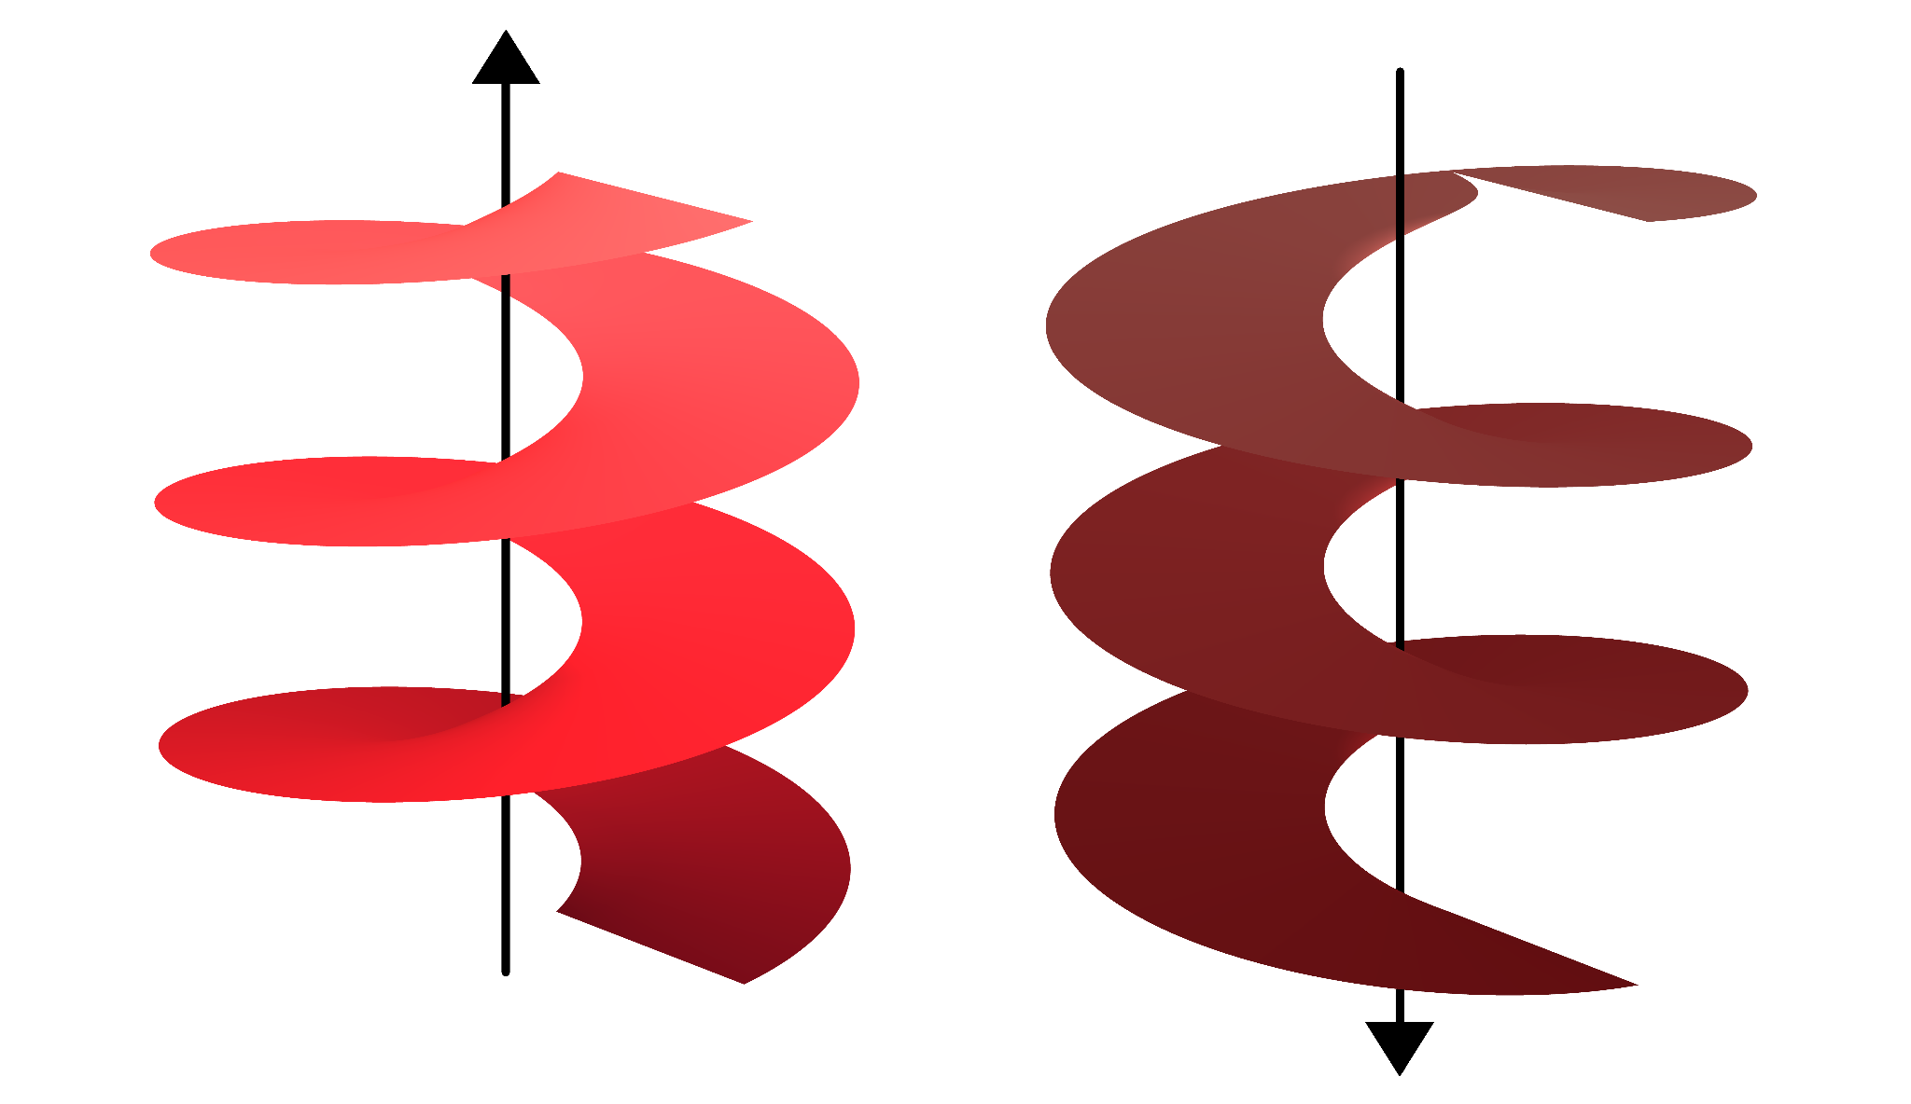
CONFIDENTIAL
The insight
Light's topological charge ℓ ∈ ℤ is an unbounded, unused measurement axis.
Polarization gives 2 states. Wavelength is bandwidth-limited. Orbital angular momentum (OAM) gives an infinite integer alphabet, with each Laguerre-Gaussian mode carrying ℓℏ per photon (Allen et al., Phys. Rev. A 45, 8185, 1992). Evidence suggests superradiant ultraweak Majorana-like biophoton bursts are how the brain manages a 20W efficiency when compared to gigawatts for supercompute/datacenters.
Why it has been missed
OAM hardware (q-plates, metasurfaces, SLMs) has fallen 10x in cost since 2020 and only matured this decade.
Topological photon states (skyrmions, hopfions) are 2022 to 2025 lab demonstrations, not yet in deployed instruments.
The unifying physics (vortex coupling to plasmas, biological tissue, gravitomagnetic fields, lattice spectra) sits across silo'd subfields and is rarely held by one team.
Previously considered fringe physics.
Majorana-like vortex photon depiction, exp(iℓφ)
Dreamscape Systems Inc. | trevornestor@dreamscapesystemsinc.com | dreamscapesystemsinc.com
3 / 13

Slide 6
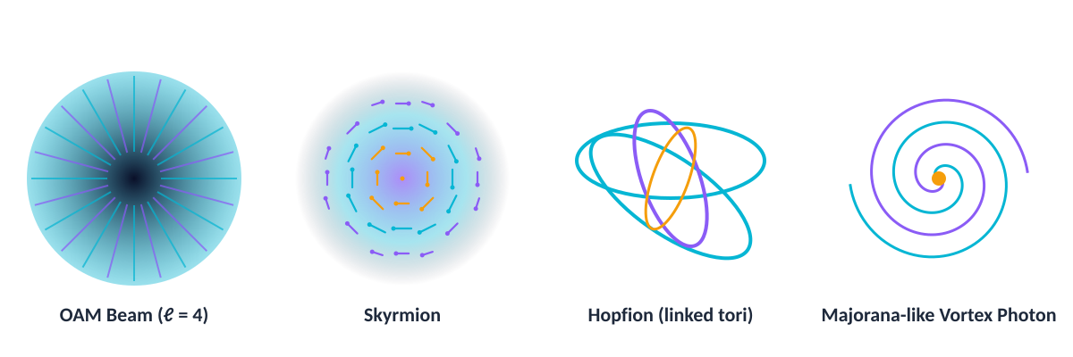
CONFIDENTIAL
Four flavors of structured light. One physical primitive.
All four carry a quantized topological invariant. All four can be generated and detected with overlapping hardware. Together they cover spatial, vector, and 3D-knotted modes of light.
Helical phase exp(iℓφ); rotational-Doppler, OAM LIDAR, free-space links to 143 km (Krenn 2016).
Topologically protected spin texture; recent optical skyrmion demonstrations (Tsesses 2018, Du 2019).
3D knotted polarization or phase field; linked-torus topology; bench demonstrations (Sugic & Dennis 2018, Ehrmanntraut 2023).
Predicted parity-sector signatures in driven-dissipative spin systems (Nestor IPI Letters 2026).
Dreamscape Systems Inc. | trevornestor@dreamscapesystemsinc.com | dreamscapesystemsinc.com
4 / 13

Slide 7
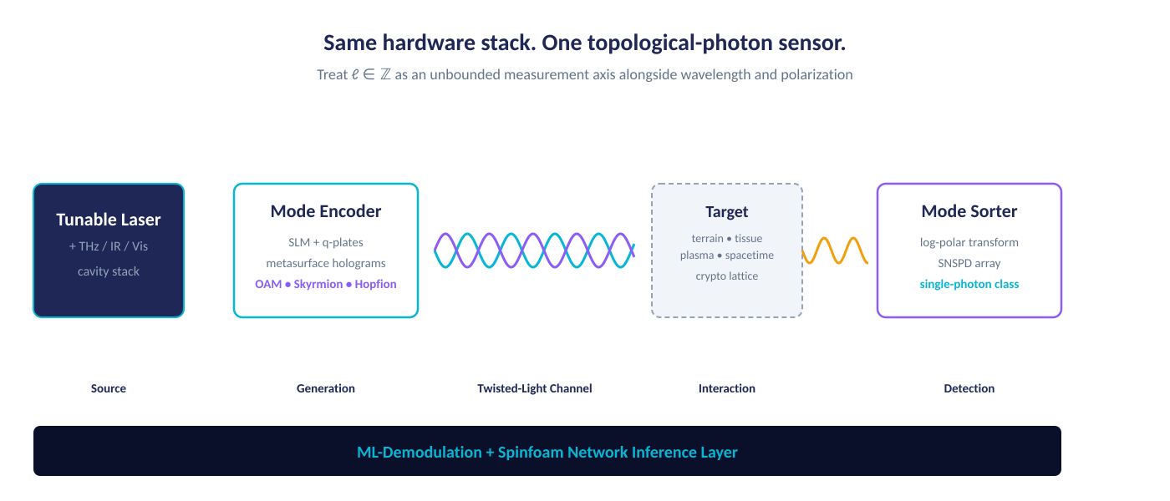
CONFIDENTIAL
What we are building
A topological-photon sensor stack that funds itself across every downstream vertical.
Same instrument, many missions
R&D capital amortizes
Defensible IP
Mode encoder, twisted-light channel, mode sorter, single-photon detection. Application is set by software and target.
Hardware investment funded once. Each vertical inherits the platform rather than rebuilding it.
USPTO Provisional 63/910,939 on superradiant vortex generation and detection architecture; follow-ons in progress.
Dreamscape Systems Inc. | trevornestor@dreamscapesystemsinc.com | dreamscapesystemsinc.com
5 / 13

Slide 8
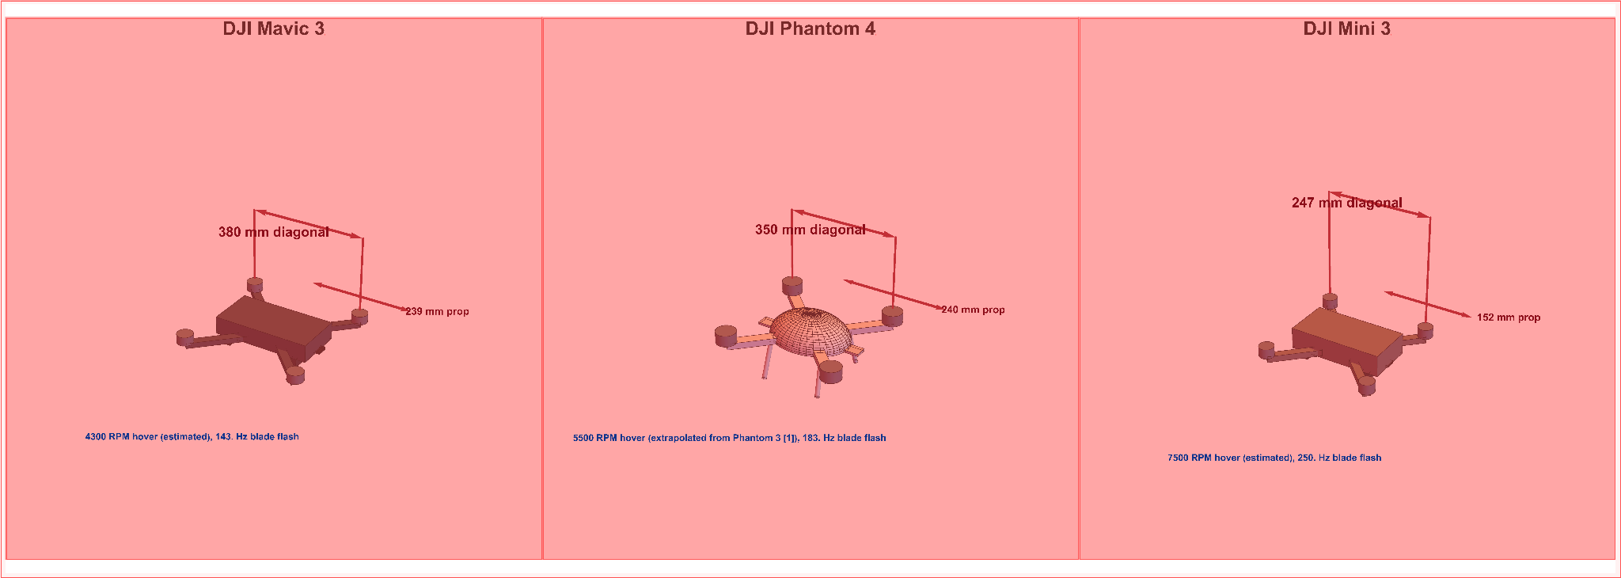
CONFIDENTIAL
One sensor. Five revenue paths.
Near-term verticals fund the platform. Forward-thesis verticals are upside, not the floor.
Vertical | What it sells | Possible Buyer | Evidence anchor | Maturity
TwistTerraScan • | OAM remote sensing | DoD counter-UAS, IC ISR, mining majors, USDA | Lavery 2013 rotational Doppler, NASA Langley wake studies | TRL 4-5 lab, 3 airborne
ZetaBreak • | Lattice cryptanalysis probe | NSA, DARPA I2O, financial-services CISOs | Nestor IPI Letters 2025/2026 SVP-spectral mapping | TRL 2-3
SpectraScan • | Vortex-photon microscopy | Top-20 pharma, academic neuroscience labs | Furhapter 2005 spiral phase contrast, Bernet 2006 | TRL 4
BioCore | OAM-multiplexed edge inference | Hyperscalers, edge AI for defense/medical | Shastri 2021 photonic AI, Zarkeshian 2022 photon backprop | TRL 4 photonic, 2 biophotonic
KerrSense | OAM gravimetry and astronomy | NGA, NASA, ESA, DARPA DSO, oil & gas | Tamburini Nature Phys 7, 195 (2011); MNRAS 492, L22 (2020) | TRL 2-3
• Near-term commercial ◆ Forward thesis (upside on Majorana-vortex hypothesis)
Additional applications detailed on dreamscapesystemsinc.com: PlasmaWeave (tokamak edge control), CyberFlow (organizational cybernetics).
Dreamscape Systems Inc. | trevornestor@dreamscapesystemsinc.com | dreamscapesystemsinc.com
6 / 13

Slide 9






CONFIDENTIAL
Why now
Hardware, physics, and procurement windows have converged in the last 24 months.
Hardware costs collapsed
Structured light moved from physics to instrumentation
Procurement appetite is at multi-decade high
Spatial light modulators, q-plates, metasurfaces, and SNSPDs have dropped ~10x in five years. A vortex generator that cost $250k in 2019 is $25k today. Meanwhile, billions of dollars are projected to be spent on inefficient data centers and supercompute clusters.
The Rubinsztein-Dunlop Roadmap on Structured Light (J. Opt. 19, 013001, 2017) and Padgett's 2024 Phil. Trans. R. Soc. A review establish industrial maturity. It’s been used even to probe gravitational waves and is tied to physics beyond the standard model.
There is a fear in the markets that quantum computers imperil cryptography - this technology could break even newer standards. Replicator, AFWERX counter-UAS, DARPA Quantum Apertures, JCO Tower-22 response. Critical minerals elevated to DPA Title III. NIST PQC migration mandate in force.
Energy wall is now CEO-level
Forward-thesis physics has aged into the open
Founder credential window
Goldman Sachs and IEA project AI data centers at 8 to 12 percent of US electricity by 2030. Hyperscalers signing nuclear PPAs. Photonic inference is on every roadmap.
Microtubule-as-topological-insulator (Subramanyan 2023), photon-guided backprop in the brain (Zarkeshian 2022), Tamburini M87* OAM spin measurement (MNRAS 2020).
Borcherds lineage (Fields Medal 1998, Monstrous Moonshine on lattices), TS/SCI history, Microsoft Azure Quantum and Meta AI infrastructure background. Hard to assemble.
Dreamscape Systems Inc. | trevornestor@dreamscapesystemsinc.com | dreamscapesystemsinc.com
7 / 13

Slide 10
CONFIDENTIAL
Evidence base
Substantiated foundations. Forward thesis disclosed honestly. Founder publications cited externally.
ESTABLISHED FOUNDATION
FRONTIER / FORWARD THESIS
OAM as a quantized photonic degree of freedom
Allen, Beijersbergen, Spreeuw, Woerdman. Phys. Rev. A 45, 8185 (1992).
OAM free-space links over 143 km
Krenn et al. PNAS 113, 13648 (2016).
Rotational-Doppler detection of spinning targets
Lavery, Padgett et al. Science 341, 537 (2013).
Spiral phase contrast microscopy
Furhapter, Jesacher, Bernet, Ritsch-Marte. Opt. Express 13, 689 (2005).
OAM imprinted by Kerr frame-dragging on M87*
Tamburini, Thide, Della Valle. MNRAS Letters 492, L22 (2020).
Structured-light roadmap, 30 co-authors
Rubinsztein-Dunlop et al. J. Opt. 19, 013001 (2017).
Photon-guided learning in cortical tissue
Zarkeshian et al. Sci. Rep. 12, 20720 (2022).
Microtubules as topological insulators
Subramanyan et al. EPL 143 (2023).
OAM conservation through biological waveguides
Perez et al. Sci. Rep. 12, 14144 (2022).
SVP-spectral correspondence on flat tori
Nestor. IPI Letters 3(2) (2025). DOI 10.59973/ipil.171.
Parity-sector UPE in driven-dissipative Majorana spins
Nestor. IPI Letters 4(1) (2026). DOI 10.59973/ipil.321.
Neural networks as spinfoam networks
Nestor. IPI Letters 3(5) (2025).
Founder publications (IPI Letters): 1,300+ reads, cited by World Economic Forum scientists. Full bibliography on trevornestor.com.
Dreamscape Systems Inc. | trevornestor@dreamscapesystemsinc.com | dreamscapesystemsinc.com
8 / 13

Slide 11
CONFIDENTIAL
Competitive landscape
Many adjacent vendors. No vendor sells a structured-light sensor that crosses verticals.
Vendor | Domain | OAM / topological photonics | Cross-vertical | Founder-published physics
Maxar, Planet, BlackSky | Remote sensing | No | No | No
Lightmatter, Lightelligence | Photonic compute | Partial (no OAM) | No | No
Zeiss, Leica, Nikon, Bruker | Microscopy | No | No | No
Muquans/iXblue, AOSense | Cold-atom gravimetry | No | No | No
PsiQuantum, Xanadu, ORCA | Photonic quantum | Adjacent (vacuum, QC) | No | No
DRS Daylight, Plasmonics startups | PQC tooling | No | No | No
Dreamscape Systems | Topological photon sensors | Yes (patent pending) | Yes (5 verticals) | Yes (peer-reviewed)
What this means: Every adjacent vendor solves one slice. The structured-light sensor that crosses domains is an open niche. Founder physics work plus credentialed lineage gives a defensible wedge.
Dreamscape Systems Inc. | trevornestor@dreamscapesystemsinc.com | dreamscapesystemsinc.com
9 / 13

Slide 12

CONFIDENTIAL
Traction and active conversations
Pre-seed traction across federal grant agencies, frontier-physics labs, and field operations. Not promises, conversations in progress.
FEDERAL & AGENCY
RESEARCH PARTNERS
FIELD & IP
USTDA
In conversation regarding grants for OAM-augmented remote sensing in East Timor, targeting gold deposits in the Aileu-Manufahi formation. Aligns with critical-minerals and allied-nation development priorities.
NSF Physics of Living Systems
Active submission relationship with Program Officer Dr. Krastan Blagoev (positive pre-submission feedback) on biophotonic sensing and parity-sector measurements.
Target program list
DARPA Quantum Apertures, AFWERX counter-UAS, NASA Earth Observation BAA, DoD SBIR Releases 2 to 6, IARPA SCITE, NATO DIANA.
Dr. Jack Tuszynski's lab
Active discussions on OAM-microtubule coupling and follow-on collaboration. Tuszynski is the leading authority on quantum effects in microtubules and a long-time Orch-OR collaborator.
Dr. Nirosha Murugan (Wilfrid Laurier)
In conversation about sensor-building collaboration for biophotonic and structured-light measurement of biological systems.
Information Physics Institute (IPI)
Founder is published researcher and Editor (Emerging Minds, Univ. Portsmouth, under Dr. Melvin Vopson). Four peer-reviewed papers; 1,300+ reads.
East Timor field reconnaissance
Active reconnaissance for Au, Cu, Ag, Cr, Mn, and REE deposits in the Aileu-Manufahi formation. National-level permit framework established. Operational baseline for sensor field validation.
USPTO Provisional 63/910,939
Filed November 2025 covering superradiant Majorana-like vortex photon generation and detection architecture. Follow-on filings in progress.
Corporate readiness
Delaware C-Corp incorporated January 2026. Five-founder cap table in place. Investor-grade governance.
Dreamscape Systems Inc. | trevornestor@dreamscapesystemsinc.com | dreamscapesystemsinc.com
10 / 13

Slide 13
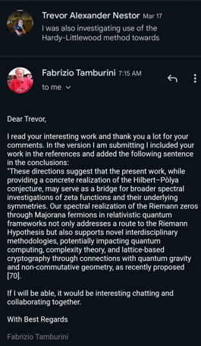
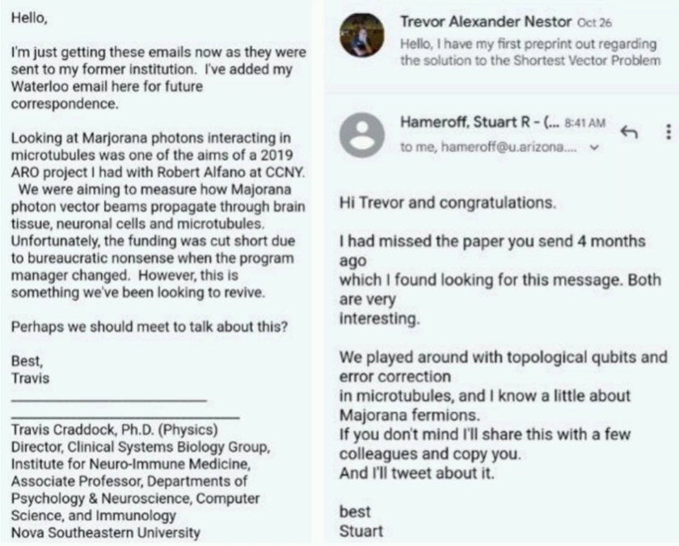

Slide 14
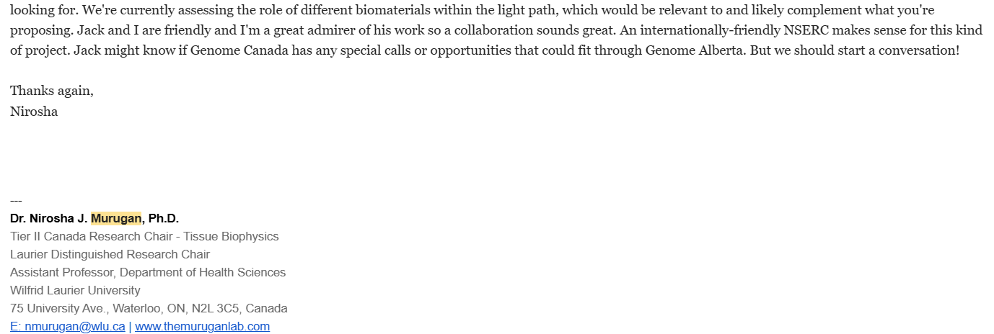
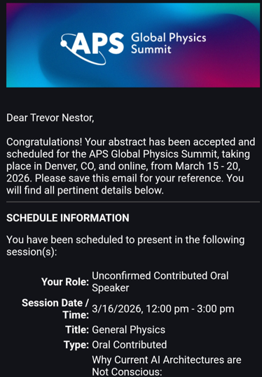
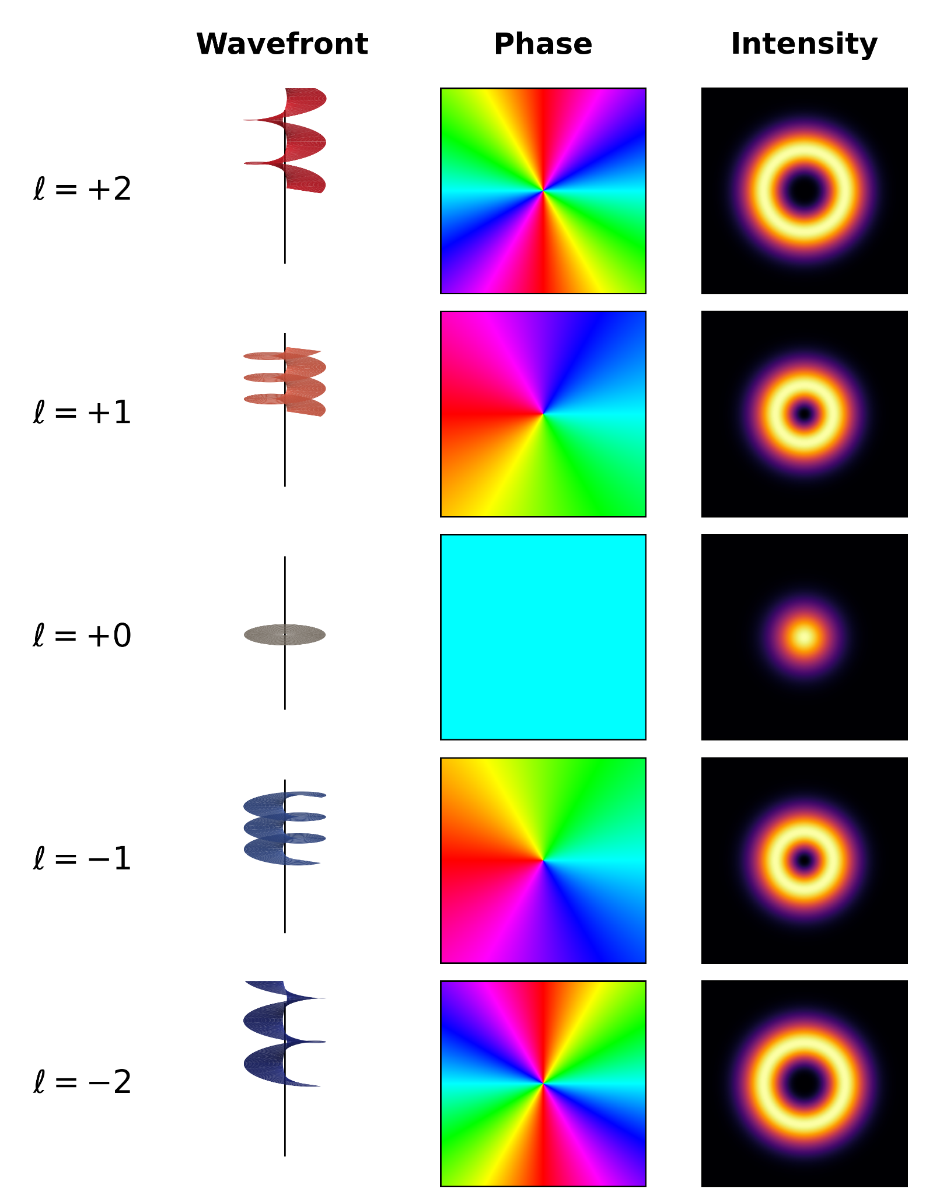
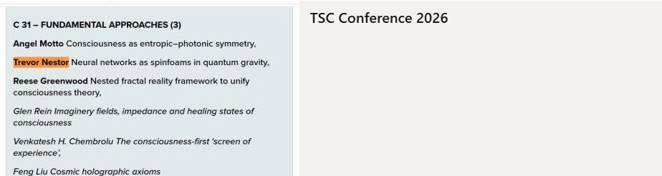

Slide 15
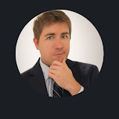
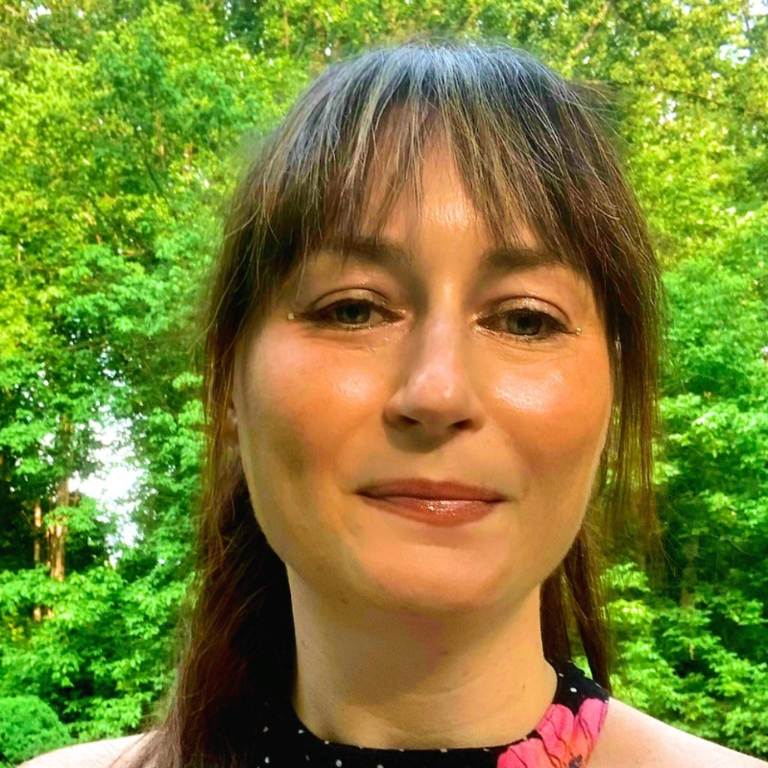
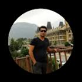
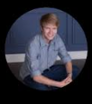
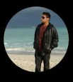
CONFIDENTIAL
Founding team
Combined experience across aerospace flight software, AI infrastructure at hyperscale, deep-tech research, and corporate operations.
Sarah Sullivan
Trevor Nestor
Co-founder
Founder & CEO
Corporate operations and finance • Co-founding Director, Dreamscape Systems Inc.
Former student of Fields Medalist Richard Borcherds (UC Berkeley EECS)
Microsoft Azure / Meta Staff Engineer (worked with 100-GPU H100 clusters)
Boeing / Aurora Flight Sciences (Orion autonomous flight, Blue Origin BE-4)
Author, peer-reviewed IPI Letters papers on lattice physics and Majorana spin - invited directly by Dr. Hameroff to present at the TSC conference, presentations at the APS and IPI conferences 2026
(Website trevornestor.com)
David Nisanov
Co-founder
Engineering and platform development • Co-founding Director, Dreamscape Systems Inc.
Brian Thompson
Co-founder
Technical operations • Co-founding Director, Dreamscape Systems Inc.
Aniket Sur
Co-founder
Engineering and product • Co-founding Director, Dreamscape Systems Inc.
Dreamscape Systems Inc. | trevornestor@dreamscapesystemsinc.com | dreamscapesystemsinc.com
11 / 13

Slide 16
CONFIDENTIAL
Use of funds and roadmap
Seed funds the shared sensor stack. Vertical-specific capital comes from a layered non-dilutive grant stack (NSF, DARPA, DoD SBIR, NASA, DOE, IARPA, ARPA-H, NATO DIANA) plus follow-on Series A.
Use of funds (24 months) | Amount
Photonics engineering team (3 hires) | $1.8M
Optical bench buildout, SLMs, mode sorters, SNSPD chain | $1.5M
Vertical demonstrators (sensing, microscopy, compute) | $1.0M
IP prosecution, FedRAMP / FIPS preparation | $0.4M
G&A, BD, government affairs | $0.3M
TOTAL ASK | $5.0M
Milestone timeline
Months 0-6
Bench prototype: OAM source + mode-sorter receiver demonstrating end-to-end channel
Months 6-12
First vertical demo (TwistTerraScan rotational-Doppler counter-UAS at outdoor range)
Months 12-18
DARPA / NSF SBIR Phase II awards; microscopy lab validation partner online
Months 18-24
Second hardware unit; ZetaBreak spectral readout demonstration; Series A close
Months 24-36
DoD / IC pilot contracts; pharma microscopy partnership; KerrSense bench gravimetry
Non-dilutive grant stack target across 24 months: $5M to $15M layered (NSF, DARPA MTO/DSO/I2O, DoD SBIR, NASA, DOE BES/FES, IARPA, ARPA-H, NATO DIANA, Templeton, FQXi, Schmidt Sciences AI2050).
Dreamscape Systems Inc. | trevornestor@dreamscapesystemsinc.com | dreamscapesystemsinc.com
12 / 13

Slide 17
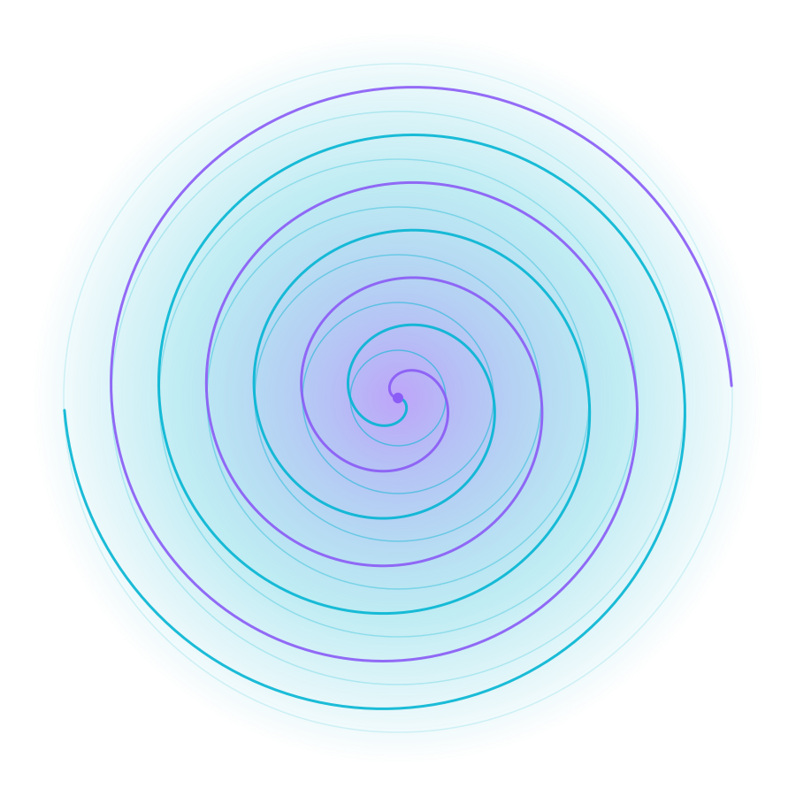
The ask
$5M Seed
$20M pre-money SAFE • Closing fall 2026
Funds the shared topological-photon sensor stack and the first two vertical demonstrators. Series A target $25M-$40M at 24 months, anchored on near-term revenue plus DoD/IC pilots.
Trevor Nestor
Founder and CEO, Dreamscape Systems Inc.
trevornestor@dreamscapesystemsinc.com
+1 720 435 7075
dreamscapesystemsinc.com • trevornestor.com
CONFIDENTIAL • May 2026 • Dreamscape Systems Inc.
13 / 13

